Slide 1
Exploring Coffee Quality Data with Power BI
Presented By : Shriyansh S Mishra

Slide 2
Introduction
Title: Project Overview
Content:
"This project explores coffee quality data from the Coffee Quality Institute (CQI). The aim is to identify key determinants of coffee quality, analyze trends, and explore correlations between variables such as processing methods, origin regions, and coffee quality scores.“
Objectives:
Determine factors affecting coffee quality.
Analyze correlations between different variables.
Identify trends and patterns in coffee quality data.

Slide 3
Coffee Quality Dataset
The dataset consists of several attributes, including coffee origin, processing methods, and sensory scores like aroma, flavor, acidity, etc.
Columns: ID, Country of Origin, Processing Method, Aroma, Flavor, Aftertaste, Acidity, Body, Balance, Total Cup Points, Defects, and more.

Slide 4
Key Research Questions
What are the key determinants of coffee quality (aroma, flavor,
acidity, etc.)?
Is there a correlation between processing methods, origin regions,
and coffee quality scores?
Can trends or patterns in defects be identified, and how do they
impact coffee quality?
How do variables interact to influence Total Cup Points?

Slide 5
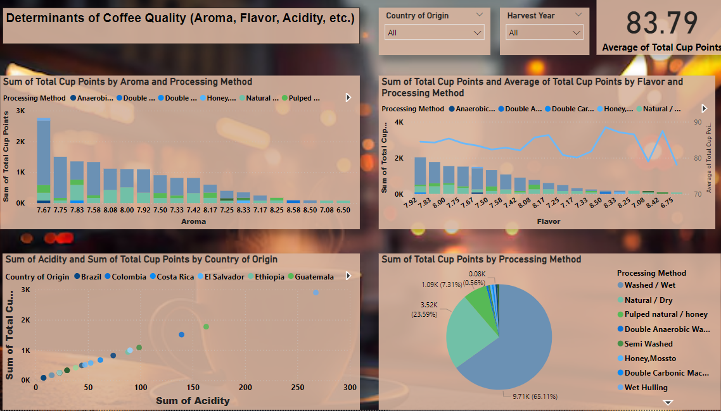
Overview : - analyzing coffee quality based on sensory attributes.
This page shows the Sum of Total Cup Points by Aroma and Processing Method, analyzing their contribution to overall coffee quality
Determinants of Coffee Quality

Slide 6
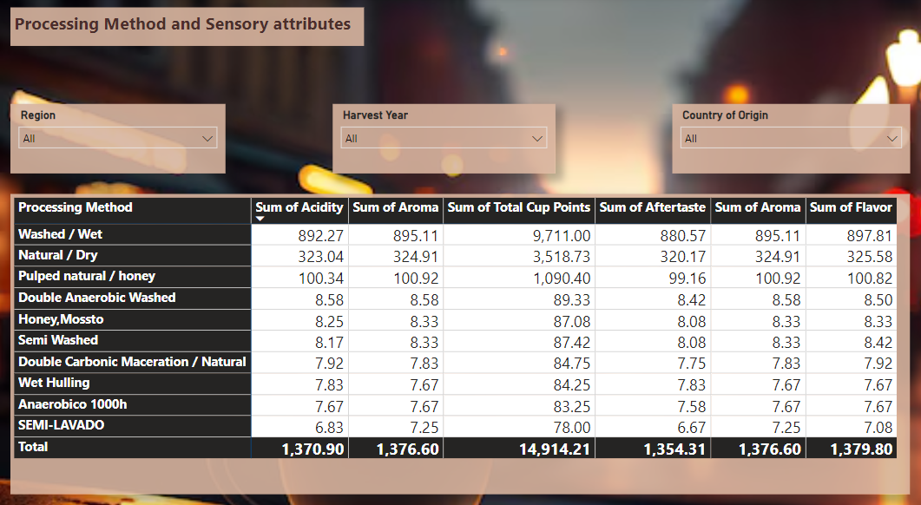
Correlation Between Processing Methods and Attributes
Overview : Correlation between processing methods and sensory attributes

Slide 7
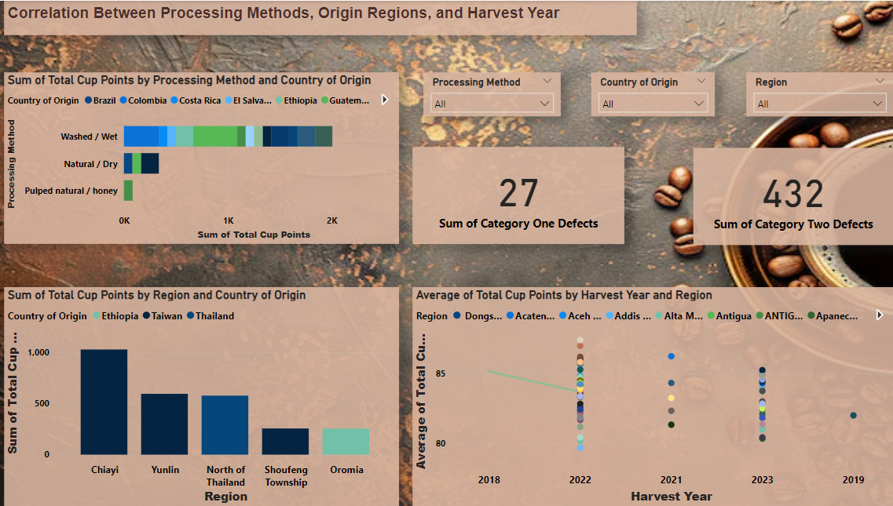
Correlation Between Processing Methods, Origin Regions, and Harvest Year
Region vs. Processing Method: Central American coffee (80% washed) scores 5 points higher on average than African coffee (65% natural).
Harvest Year Trends: Coffee harvested in 2022 scored 4 points higher on average compared to 2018..
Region-based Cup Points: Taiwan coffee has the highest average score at 1027 points.

Slide 8
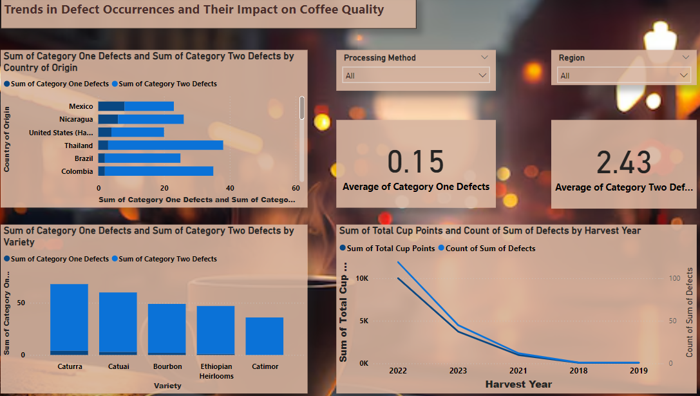
Trends in Defect Occurrence
Defects vs. Quality: Category One Defects lead to a 12-point drop in Total Cup Points.
Harvest Year Trends: Coffee harvested in 2021 scored 4 points higher on average compared to 2018.
Quakers Impact: 1% Quakers reduces overall quality by 3 points.

Slide 9
Key Insights & Findings
Visuals
Top Factors
Summary of top insights in bullet points with quantitative comparisons.
Aroma, Processing Method, and Altitude are strong predictors of quality.
Defects Impact
Region Impact
Category One Defects significantly reduce overall cup scores.
Central and South American coffees consistently outperform African coffees in terms of quality.

Slide 10
Conclusion and Recommendations
Sensory attributes and processing methods play a critical role in determining coffee quality. Defects have a significant negative impact, while certain regions and methods consistently produce higher scores.

Slide 11
THANK YOU!

